Slide 1
welcome to
COMP 2691
Intermediate Windows Application Development in .NET
Week 3
GUI Concepts (Part One)
Amir Ahani, M.Sc. + MBA
Microsoft Certified Solution Developer (MCSD .NET)
Microsoft Certified Database Administrator (MCDBA)
Email: amirahani@gmail.com
<number> of 38
Notes:
COMP2690 Windows Application Development with C#

Slide 2
Today…
Event Handling
  Delegates and the Event-Handling Mechanism
  Mouse-Event Handling
  Keyboard-Event Handling
Windows Forms Controls
  The LinkLabel Control
  Scrollbar Controls
  Provider Controls
  The MonthCalendar Control
  The DataTimePicker Control
  The DomainUpDown Control
  The TrackBar Control
  The MaskedTextBox Control
<number> of 38
Notes:
COMP2690 Windows Application Development with C#

Slide 3
Today…
Custom Control Creation
  Inheriting from an Existing Control
  Improving the Custom Control
  Composing Multiple Controls
  Creating a Control from Scratch
Lab: Using DateTimePicker Control
Lab: Using MaskedTextBox Control
Lab: Composing Multiple Controls
<number> of 38
Notes:
COMP2690 Windows Application Development with C#

Slide 4
Delegates & Event-Handling Mechanism
By convention, C# names the event-handler method as controlName_eventName.
The control that generates an event is known as the event sender.
An event-handling method– known as the event receiver– responds
to a particular event that a control generates.
The .NET event-handling mechanism allows you to choose your
own names for event-handling methods. However, each event-
handling method must declare the proper parameters to receive
information about the event that it handles. Since you can choose
your own method names, an event sender such as a Button can not
know in advance which method will respond to its events. So, we
need a mechanism to indicate which method is the event receiver
for an event.
Event handlers are connected to a control’s events via special
objects called delegates. A delegate object holds a reference to a
method with a signature that is specified by the delegate type’s
declaration.
<number> of 38
Notes:
COMP2690 Windows Application Development with C#

Slide 5
Delegates & Event-Handling Mechanism
Cont’d
GUI controls have predefined delegates that correspond to every event they can generate.
For example, the delegate for a Button’s Click event is of type EventHandler (namespace System). If you look at this type in the online help documentation, you will see that is declared as follows:
public delegate void EventHandler ( object sender, EventArgs e );
This uses the delegate keyword to declare a delegate type named EventHandler, which can hold references to methods that return void and receive two parameters– one of type object (the event sender) and one of type EventArgs.
If you compare the delegate declaration with clickButton_Click’s header:
private void clickButton_Click( object sender, EventArgs e);
You will see that this event handler indeed meets the requirement of the event handler delegate.
<number> of 38
Notes:
COMP2690 Windows Application Development with C#

Slide 6
Delegates & Event-Handling Mechanism
Cont’d
An event sender calls a delegate object like a method. The delegate’s job is to invoke the appropriate method. To enable the clickButton_Click metod to be called, visual studio assigns clickButton_Click to the delegate as shown here:
this.clickButton.Click += new System.EventHandler(this.clickButton_Click);
The new System.EventHandler(this.clickButton_Click) cretaes an EventHandler delegate object and initializes it with the clickButton_Click method.
You can actually specify that several different methods should be invoked in response to an event by adding other delegates to the Button’s Click event with statement similar to:
this.clickButton.Click += new System.EventHandler(this.clickButton_Click);
Event delegates are multicast—they represent a set of delegate objects that all have the same signature. Multicast delegates enable several methods to be called in response to a single event.
<number> of 38
Notes:
COMP2690 Windows Application Development with C#

Slide 7
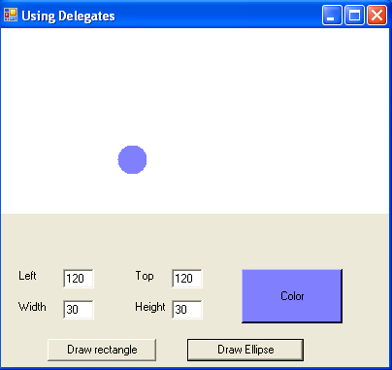
Case Study
Creating and Using Simple Delegates
<number> of 38
Notes:
COMP2690 Windows Application Development with C#

Slide 8
Mouse-Event Handling
Mouse events can be handled for any control that derives from
class System.Windows.Forms.Control. For most mouse events,
information about the event is passed to the event-handling method
through an object of class MouseEventArgs, and the delegate used
to create the mouse-event handlers is MouseEventHandler.
Mouse events and event arguments
Mouse Events with Event Argument of Type EventArgs
MouseEnter | Occurs when the mouse cursor enters the control’s boundaries.
MouseLeave | Occurs when the mouse cursor leaves the control’s boundaries.
Mouse Events with Event Argument of Type MouseEventArgs
MouseDown | Occurs when a mouse button is pressed while the mouse cursor is within a control’s boundaries.
MouseHover | Occurs when the mouse cursor hovers within the control’s boundaries.
MouseMove | Occurs when the mouse is moved while in the control’s boundaries.
MouseUp | Occurs when a mouse button is released when the cursor is over the control’s boundaries.
Button | Specifies which mouse button was pressed (Left, Right, Middle or none)
Clicks | The number of times that the mouse button was clicked.
X | The x-coordinate within the control where the event occurred.
Y | The y-coordinate within the control where the event occurred.
<number> of 38
Notes:
COMP2690 Windows Application Development with C#

Slide 9
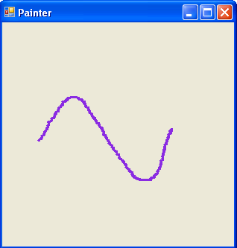
Example
// creates a Form that is a drawing surface
public partial class PainterForm : Form
{
bool shouldPaint = false; // determines whether to paint
// should paint when mouse button is pressed down
private void PainterForm_MouseDown( object sender, MouseEventArgs e )
{ shouldPaint = true; } // end method Painter_MouseDown
// stop painting when mouse button is released
private void PainterForm_MouseUp( object sender, MouseEventArgs e )
{
shouldPaint = false;
} // end method Painter_MouseUp
// draw circle whenever mouse moves with its button held down
private void PainterForm_MouseMove( object sender, MouseEventArgs e )
{
if ( shouldPaint ) // check if mouse button is being pressed
{
// draw a circle where the mouse pointer is present
Graphics graphics = CreateGraphics();
graphics.FillEllipse(
new SolidBrush( Color.BlueViolet ), e.X, e.Y, 4, 4 );
graphics.Dispose();
} // end if
} // end method Painter_MouseMove
} // end class PainterForm
<number> of 38
Notes:
COMP2690 Windows Application Development with C#

Slide 10
Keyboard-Event Handling
Key events occur when keyboard keys are pressed and released.
Such events can be handled for any control that inherits from class
System.Windows.Forms.Control. There are three key events–
KeyPress, KeyUp and KeyDown. The KeyPress event occurs when
the user presses a key that represents an ASCII character. The
specific key can be determined with property KeyChar of the event
handler’s KeyPressEventArgs argument.
The KeyPress event does not indicate whether modifier keys (e.g.,
Shift, Alt and Ctrl) were pressed when a key event occurred. If this
information is important, the KeyUP or KeyDown events can be used.
The KeyEventArgs argument for each of these events contains
information about modifier keys.
<number> of 38
Notes:
COMP2690 Windows Application Development with C#

Slide 11
Keyboard-Event Handling
Keyboard events and event arguments
Key Events with Event Arguments of Type KeyEventArgs
KeyDown | Generated when a key is initially pressed.
KeyUp | Generated when a key is released.
Key Events with Event Argument of Type KeyPressEventArgs
KeyPress | Generated when a key is pressed.
Class KeyPressEventArgs Properties
KeyChar | Returns the ASCII character for the key pressed.
Handled | Indicates whether the KeyPress event was handled.
Class KeyEventArgs Properties
Alt | Indicates whether the Alt key was pressed.
Control | Indicates whether the Ctrl key was pressed.
Shift | Indicates whether the Shift key was pressed.
Handled | Indicates whether the event was handled.
KeyCode | Returns the key code for the key as a value from the key enumeration. This does not include modifier-key information. It is used to test for a specific key.
KeyData | Returns the key code for a key combined with modifier information as a keys value. This property contains all information about the pressed key.
KeyValue | Returns the key code as an int, rather than as a value from the keys enumeration. This property is used to obtain a numeric representation of the pressed key. The int value is known as a Windows virtual key code.
Modifiers | Returns a keys value indicating any pressed modifier keys (Alt, Ctrl and Shift). This property is used to determine modifier-key information only.
<number> of 38
Notes:
COMP2690 Windows Application Development with C#

Slide 12
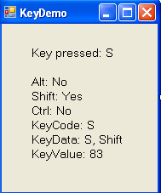
Example
// display the character pressed using KeyChar
private void KeyDemoForm_KeyPress( object sender, KeyPressEventArgs e )
{
charLabel.Text = "Key pressed: " + e.KeyChar;
} // end method KeyDemo_KeyPress
// display modifier keys, key code, key data and key value
private void KeyDemoForm_KeyDown( object sender, KeyEventArgs e )
{
keyInfoLabel.Text =
"Alt: " + ( e.Alt ? "Yes" : "No" ) + '\n' +
"Shift: " + ( e.Shift ? "Yes" : "No" ) + '\n' +
"Ctrl: " + ( e.Control ? "Yes" : "No" ) + '\n' +
"KeyCode: " + e.KeyCode + '\n' +
"KeyData: " + e.KeyData + '\n' +
"KeyValue: " + e.KeyValue;
} // end method KeyDemo_KeyDown
// clear Labels when key released
private void KeyDemoForm_KeyUp( object sender, KeyEventArgs e )
{
charLabel.Text = "";
keyInfoLabel.Text = "";
} // end method KeyDemo_KeyUp
<number> of 38
Notes:
COMP2690 Windows Application Development with C#

Slide 13
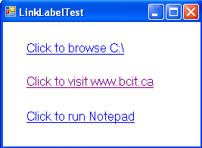
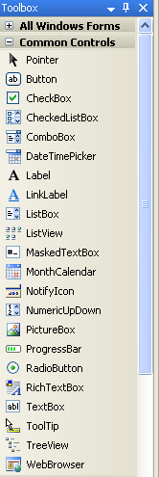
LinkLabel Control
  To display link to other resources, such
  as files or Web Pages.
LinkLable
AlwaysUnderline, HoverUnderline, NeverUnderline
Properties
LinkArea, LinkBehavior, LinkColor, ActiveLinkColor,
Text, UseMnemonic, LinkVisited, VisitedLinkColor
Event
LinkClicked
True (the & character acts as a shortcut), False
True, False
<number> of 38
Notes:
COMP2690 Windows Application Development with C#

Slide 14
Example
// browse C:\ drive
private void driveLinkLabel_LinkClicked( object sender,
LinkLabelLinkClickedEventArgs e )
{
driveLinkLabel.LinkVisited = true;
// change LinkColor after it has been clicked
System.Diagnostics.Process.Start( @"C:\" );
} // end method driveLinkLabel_LinkClicked
// load www.bcit.ca in web browser
private void bcitLinkLabel_LinkClicked( object sender,
LinkLabelLinkClickedEventArgs e )
{
deitelLinkLabel.LinkVisited = true;
// change LinkColor after it has been clicked
System.Diagnostics.Process.Start( "IExplore", "http://www.bcit.ca" );
} // end method bcitLinkLabel_LinkClicked
// run application Notepad
private void notepadLinkLabel_LinkClicked( object sender,
LinkLabelLinkClickedEventArgs e )
{
notepadLinkLabel.LinkVisited = true;
// change LinkColor after it has been clicked
// program called as if in run
// menu and full path not needed
System.Diagnostics.Process.Start( "notepad" );
} // end method driveLinkLabel_LinkClicked
<number> of 38
Notes:
COMP2690 Windows Application Development with C#

Slide 15
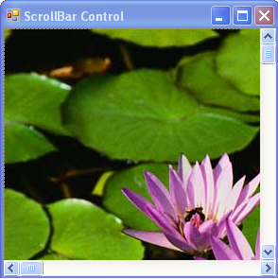
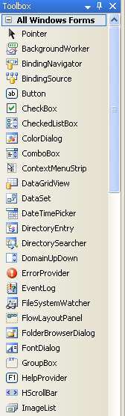
HScrollBar and VScrollBar Controls
  To display horizontal and vertical
  scrollbars.
Properties
LargeChange, SmallChange, Maximum, Minimum,
Value
Event
Scroll
<number> of 38
Notes:
COMP2690 Windows Application Development with C#

Slide 16
Lab: Using the ScrollBar Controls
1. Create a Windows Application. Add a Windows form to the project. Name the form ScrollBar Controls.
2. Place a PictureBox control, an HScrollBar control, and a VScrollBar control on the form. Name the PictureBox control pbImage and set the SizeMode property to AutoSize. Select the image property and click the elipsis (…) button. This causes an Open File Dialog box to apear. Select the image you want to have uploaded in the form.
3. Name the HScrollBar control hScroll and sets its Dock property to bottom. Change the name property of the VScrollBar control to vScroll and set its Dock property to Right.
4. Double-click the HScrollBar and VScrollBar controls to attach event handlers to their default scroll events. Add the following code to the event handlers:
private void vScroll_Scroll(object sender, System.Windows.Forms.ScrollEventArgs e)
{
//Scroll the image vertically
pbImage.Top = vScroll.Bottom - pbImage.Height - (int)getVScrollAdjustment();
}
private float getVScrollAdjustment()
{
//Calculate vertical scroll bar changes
float vPos = (float)(vScroll.Value - vScroll.Minimum);
float vDiff = (float)(vScroll.Height - pbImage.Height);
float vTicks = (float)(vScroll.Maximum - vScroll.Minimum);
return (vDiff/vTicks)*vPos;
}
private void hScroll_Scroll(object sender, System.Windows.Forms.ScrollEventArgs e)
{
//Scroll the image horizontally
pbImage.Left = hScroll.Right - pbImage.Width - (int)getHScrollAdjustment();
}
private float getHScrollAdjustment()
{ //Calculate horizontal scroll bar changes
float hPos = (float)(hScroll.Value - hScroll.Minimum);
float hDiff = (float)(hScroll.Width - pbImage.Width);
float hTicks = (float)(hScroll.Maximum - hScroll.Minimum);
return (hDiff/hTicks)*hPos;
}
<number> of 38
Notes:
COMP2690 Windows Application Development with C#

Slide 17
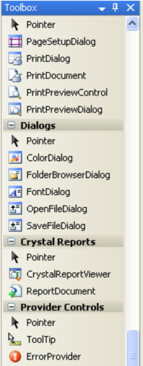
Provider Controls
  To add new properties to all the controls on the form. The windows
  form namespace includes the following provider controls:
  ToolTip Control
  ErrorProvider Control
<number> of 38
Notes:
COMP2690 Windows Application Development with C#

Slide 18
ToolTip Control – Provider Controls
  To enable any control on a form to display a ToolTip when the
  mouse hovers over it.
  The ToolTip control appears in the designer’s
  component tray area with the name of ToolTip1. It adds
  the “ToolTip on ToolTip1” property to all the controls on
  the form.
Methods
SetToolTip, GetToolTip, CanExtend
<number> of 38
Notes:
COMP2690 Windows Application Development with C#

Slide 19
Example
// Assign a ToolTip to the TextBox1 control.
toolTip1.SetToolTip(txtProduct, "Enter the name of the product");
Console.WriteLine(toolTip1.GetToolTip(txtProduct));
// Clear the ToolTip for all the controls on this form.
foreach (Control ctrl in this.Controls)
{
if (toolTip1.CanExtend(ctrl))
toolTip1.SetToolTip(ctrl,“");
}
<number> of 38
Notes:
COMP2690 Windows Application Development with C#

Slide 20
ErrorProvider Control – Provider Controls
  To be able to implement Windows Forms applications that use a
  validation method now familiar to all internet users.
  The ErrorProvider control appears in the designer’s
  component tray area with the name of ErrorProvider1.
  It adds the following properties to controls on forms:
  IconAlignment, IconPadding
TopLeft, TopRight, MiddleLeft, MiddleRight, BottomLeft, BottomRight
Properties
BlinkStyle, BlinkRate, Icon
Methods
SetError
BlinkIfDifferentError, AlwaysBlink, NeverBlink
<number> of 38
Notes:
COMP2690 Windows Application Development with C#

Slide 21
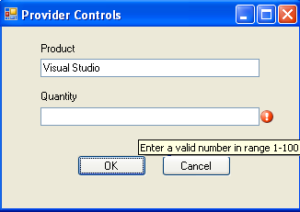
Example
// Assume it's OK to close the form.
this.DialogResult = DialogResult.OK;
// Clear all error icons.
errorProvider1.SetError(txtProduct, "");
errorProvider1.SetError(txtQty, "");
// Check that first field contains something.
if (txtProduct.Text == "")
{
errorProvider1.SetError(txtProduct, "Must enter a product name");
this.DialogResult = DialogResult.None;
}
try
{ // Attempt to get a valid quantity in second field.
int qty = Convert.ToInt32(txtQty.Text);
// Throw a generic error if out of range.
if (qty < 1 || qty > 100) throw new Exception();
}
catch
{
// Regardless of the exception type, use the same error message
errorProvider1.SetError(txtQty, "Enter a valid number in range 1-100");
this.DialogResult = DialogResult.None;
}
// Close the form only if validation passed.
// (This line is not really required if this is a dialog box.)
if (this.DialogResult == DialogResult.OK) this.Close();
<number> of 38
Notes:
COMP2690 Windows Application Development with C#

Slide 22
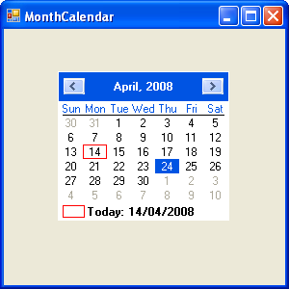
MonthCalendar Control
  To display a monthly calendar on the
  form.
Current day is outlined
Selected day is highlighted
Properties
FirstDayofWeek, MaxDate, MinDate, MaxSelectionCount,
MonthlyBoldedDates, SelectionStart, SelectionEnd,
SelectionRange
Event
DateChanged
<number> of 38
Notes:
COMP2690 Windows Application Development with C#

Slide 23
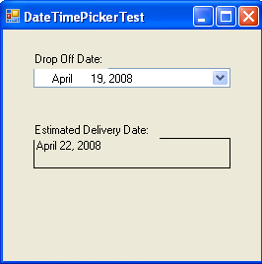
DateTimePicker Control
  To retrieve data and time information
  from the user.
DateTimePicker Control
Properties
CalendarForeColor, CalendarMonthBackground,
CustomFormat, Format, MinDate, MaxDate,
ShowCheckBox, ShowUpDown, Value
Event
ValueChanged
Long, Short, Time, Custom
<number> of 38
Notes:
COMP2690 Windows Application Development with C#

Slide 24
Example
private void dateTimePickerDropOff_ValueChanged( object sender, EventArgs e )
{
DateTime dropOffDate = dateTimePickerDropOff.Value;
// add extra time when items are dropped off around Sunday
if ( dropOffDate.DayOfWeek == DayOfWeek.Friday ||
dropOffDate.DayOfWeek == DayOfWeek.Saturday ||
dropOffDate.DayOfWeek == DayOfWeek.Sunday )
//estimate three days for delivery
outputLabel.Text = dropOffDate.AddDays( 3 ).ToLongDateString();
else
// otherwise estimate only two days for delivery
outputLabel.Text = dropOffDate.AddDays( 2 ).ToLongDateString();
} // end method dateTimePickerDropOff_ValueChanged
private void DateTimePickerForm_Load( object sender, EventArgs e )
{
// user cannot select days before today
dateTimePickerDropOff.MinDate = DateTime.Today;
// user can only select days of this year
dateTimePickerDropOff.MaxDate = DateTime.Today.AddYears( 1 );
} // end method DateTimePickerForm_Load
} // end class DateTimePickerForm
<number> of 38
Notes:
COMP2690 Windows Application Development with C#

Slide 25
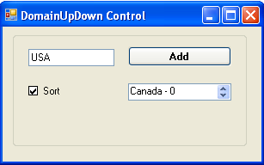
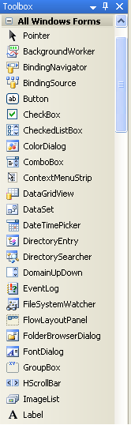
DomainUpDown Control
  To display a single string value that is selected from an Object collection.
DomainUpDown Control
Properties
ReadOnly, Sorted, UpDownAlign, Text, TextAlign
Event
SelectedItemChanged
True, False
Right, Left
<number> of 38
Notes:
COMP2690 Windows Application Development with C#

Slide 26
Example
static int myCounter = 0;
private void btnAdd_Click(object sender, EventArgs e)
{ // Add the text box contents and initial location in the collection
// to the DomainUpDown control.
domainUpDownCountryName.Items.Add((txtCountryName.Text.Trim()) + " - " + myCounter);
// Increment the counter variable.
myCounter = myCounter + 1;
// Clear the TextBox.
txtCountryName.Text = "";
}
private void chkSorted_CheckedChanged(object sender, EventArgs e)
{
// If Sorted is set to true, set it to false; otherwise set it to true.
if (domainUpDownCountryName.Sorted)
{ domainUpDownCountryName.Sorted = false; }
else { domainUpDownCountryName.Sorted = true; }
}
private void domainUpDownCountryName_SelectedItemChanged(object sender, EventArgs e)
{ // Display the SelectedIndex and SelectedItem property values in a MessageBox.
MessageBox.Show("SelectedIndex: " + domainUpDownCountryName.SelectedIndex.ToString()
+ "\n" + "SelectedItem: " + domainUpDownCountryName.SelectedItem.ToString());
}
<number> of 38
Notes:
COMP2690 Windows Application Development with C#

Slide 27
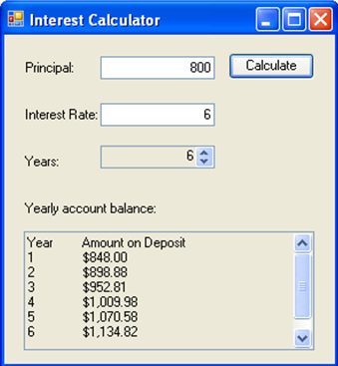
NumericUpDown Control
  To restrict a user’s input choices to
  specific range of values.
NumericUpDown
Properties
Increment, Maximum, Minimum, UpDownAlign, Value
Event
ValueChanged
Right, Left
<number> of 38
Notes:
COMP2690 Windows Application Development with C#

Slide 28
Example
// declare variables to store user input
decimal principal; // store principal
double rate; // store interest rate
int year; // store number of years
decimal amount; // store amount
string output; // store output
// retrieve user input
principal = Convert.ToDecimal( principalTextBox.Text );
rate = Convert.ToDouble( interestTextBox.Text );
year = Convert.ToInt32( yearUpDown.Value );
// set output header
output = "Year\tAmount on Deposit\r\n";
// calculate amount after each year and append to output
for ( int yearCounter = 1; yearCounter <= year;
yearCounter++ )
{
amount = principal *
( ( decimal ) Math.Pow( ( 1 + rate / 100 ), yearCounter ) );
output += ( yearCounter + "\t" +
String.Format( "{0:C}", amount ) + "\r\n" );
} // end for
<number> of 38
Notes:
COMP2690 Windows Application Development with C#

Slide 29

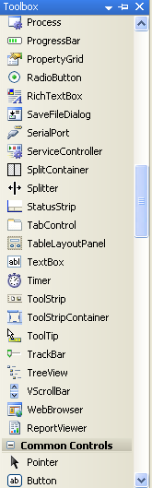
Trackbar Control
  To provide an intuitive way to select a
  value from a given range.
Trackbar Control
Properties
LargeChange, SmallChange, Maximum, Minimum,
Orientation, TickFrequency, TickStyle, Value,
Event
Scroll
Horizontal, Vertical
<number> of 38
Notes:
COMP2690 Windows Application Development with C#

Slide 30
Example
public partial class Form1 : Form
{
private System.Windows.Forms.TrackBar trackBar1;
private System.Windows.Forms.TextBox textBox1;
public Form1()
{
InitializeComponent();
this.textBox1 = new System.Windows.Forms.TextBox();
this.trackBar1 = new System.Windows.Forms.TrackBar();
// TextBox for TrackBar.Value update.
this.textBox1.Location = new System.Drawing.Point(240, 16);
this.textBox1.Size = new System.Drawing.Size(48, 20);
// Set up how the form should be displayed.
this.ClientSize = new System.Drawing.Size(296, 62);
this.Controls.AddRange(new System.Windows.Forms.Control[] { this.textBox1, this.trackBar1 }); // Add the controls to the form.
this.Text = "TrackBar Example";
// Set up the TrackBar.
this.trackBar1.Location = new System.Drawing.Point(8, 8);
this.trackBar1.Size = new System.Drawing.Size(224, 45);
this.trackBar1.Scroll += new System.EventHandler(this.trackBar1_Scroll);
// The Maximum property sets the value of the track bar when
// the slider is all the way to the right.
trackBar1.Maximum = 30;
// The TickFrequency property establishes how many positions
// are between each tick-mark.
trackBar1.TickFrequency = 5;
// The LargeChange property sets how many positions to move
// if the bar is clicked on either side of the slider.
trackBar1.LargeChange = 3;
// The SmallChange property sets how many positions to move
// if the keyboard arrows are used to move the slider.
trackBar1.SmallChange = 2;
}
private void trackBar1_Scroll(object sender, System.EventArgs e)
{
// Display the trackbar value in the text box.
textBox1.Text = "" + trackBar1.Value;
}
<number> of 38
Notes:
COMP2690 Windows Application Development with C#

Slide 31
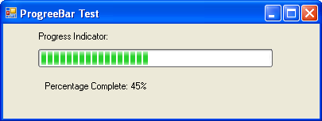
ProgressBar Control
  To indicate the status of a lengthy
  operation.
ProgressBar Control
Properties
Maximum, Minimum, Value
<number> of 38
Notes:
COMP2690 Windows Application Development with C#

Slide 32

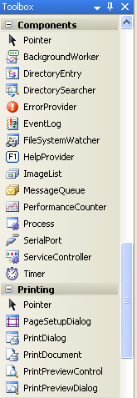
Timer Control
  The Timer component is used when an event
  needs to be generated at user-defined intervals.
Practical Tip: Timer classes
The three Timer classes are:
1- System.Threading.Timer
2- System.Windows.Forms.Timer
This timer class fires events on the same thread as the Form using the
WM_TIMER window message. The System.Windows.Forms.Timer timer is not
related to the System.Threading.Timer timer.
3- System.Timers.Timer
A wrapper around the System.Threading.Timer to support dropping it on
various Visual Studio design surfaces
System.Windows.Forms.Timer Versus System.Timers.Timer
Always use the Timer class from the System.Windows.Forms namespace in
windows forms because this class is optimized to work with forms.
System.Timers.Timer class fires Tick events from another thread and may
cause indeterminate results in applications.
Properties
Enabled, Interval
Methods
Start, Stop
Events
Tick
<number> of 38
Notes:
COMP2690 Windows Application Development with C#

Slide 33
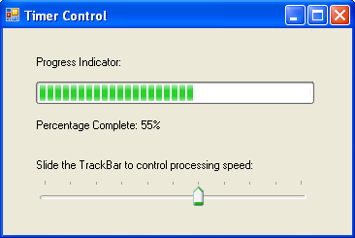
Lab: Using the Timer Control
1. Create a Windows Application. Add a Windows form to the project. Name the form Timer Control Test.
2. Place a Timer component on the form. This component is added to the component tray. Name the Timer component tmrTimer and set its Enabled property to true.
3. Place four Label controls, one ProgressBar control, and one TrackBar control on the form and arrange them as shown in Figure 1.
4. Name the ProgressBar control prgIndicator and the TrackBar control trkSpeed. For the TrackBar control, change the Maximum property to 1000, TickFrequency to 100, TickStyle to Top, Left, and Value to 100.
5. Name a Label control lblMessage.
6. Double-click the Timer component and TrackBar control to attach default event handlers to their default events Tick and Scroll, respectively. Add the following code to the event handlers:
private void tmrTimer_Tick(object sender, EventArgs e)
{
if (prgIndicator.Value < prgIndicator.Maximum)
// Increase the ProgressBar indicator
prgIndicator.Value += 5;
else
// Reset the ProgressBar indicator
prgIndicator.Value = prgIndicator.Minimum;
lblMessage.Text = "Percentage Complete: " + prgIndicator.Value + "%";
}
private void trkSpeed_Scroll(object sender, EventArgs e)
{
TrackBar trkSpeed = (TrackBar)sender;
if (trkSpeed.Value >= 1)
// Set timer value based on user's selection
tmrTimer.Interval = trkSpeed.Value;
}
<number> of 38
Notes:
COMP2690 Windows Application Development with C#

Slide 34
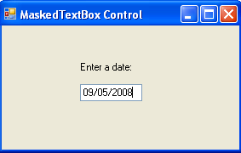
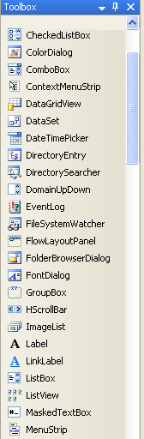
MaskedTextBox Control
  To distinguish between proper and
  improper user input.
Properties
Mask, BeepOnError, ValidatingType
Event
MaskInputRejected
<number> of 38
Notes:
COMP2690 Windows Application Development with C#

Slide 35
Example
private void frmMaskedTextBox_Load(object sender, EventArgs e)
{
maskedTextBox1.Mask = "00/00/0000";
maskedTextBox1.MaskInputRejected += new MaskInputRejectedEventHandler(maskedTextBox1_MaskInputRejected);
maskedTextBox1.ValidatingType = typeof(System.DateTime);
maskedTextBox1.TypeValidationCompleted += new TypeValidationEventHandler(maskedTextBox1_TypeValidationCompleted);
}
void maskedTextBox1_MaskInputRejected(object sender, MaskInputRejectedEventArgs e)
{
toolTip1.ToolTipTitle = "Invalid Input";
toolTip1.Show("We're sorry, but only digits (0-9) are allowed in dates.", maskedTextBox1, maskedTextBox1.Location, 5000);
}
public void maskedTextBox1_TypeValidationCompleted(object sender, TypeValidationEventArgs e)
{
if (!e.IsValidInput)
{
toolTip1.ToolTipTitle = "Invalid Date Value";
toolTip1.Show("We're sorry, but the value you entered is not a valid date. Please change the value.", maskedTextBox1, 5000);
e.Cancel = true;
}
}
<number> of 38
Notes:
COMP2690 Windows Application Development with C#

Slide 36
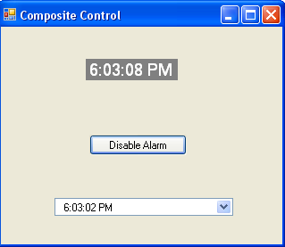
Lab: Create a Composite Control
<number> of 38
Notes:
COMP2690 Windows Application Development with C#

Slide 37
Summary
Event Handling
  Delegates and the Event-Handling Mechanism
  Mouse-Event Handling
  Keyboard-Event Handling
Windows Forms Controls
  The LinkLabel Control
  Scrollbar Controls
  Provider Controls
  The MonthCalendar Control
  The DataTimePicker Control
  The DomainUpDown Control
  The TrackBar Control
  The MaskedTextBox Control
<number> of 38
Notes:
COMP2690 Windows Application Development with C#

Slide 38
Summary
Custom Control Creation
  Inheriting from an Existing Control
  Improving the Custom Control
  Composing Multiple Controls
  Creating a Control from Scratch
<number> of 38
Notes:
COMP2690 Windows Application Development with C#

